Slide 1

Train the trainers session
20-21 April 2016
Managing visual support

Slide 2
Objectif and organisation
Objectives
The principles of using teaching aids (slides, paper board etc. ...)
The trainer's role in a situation where he/she has to deliver information
Organisation
Exercise
Debriefing
Additional inputs
Notes:
ADEME Formation - Edition 2007
BILAN CARBONE
2

Slide 3
Exercise
Objective: To control the use of media, while integrating education and entertainment aspects of the group.
Organization: 2 trainers make ​​the presentation, others can ask questions.
Instructions: present the slides of sequence on
  energy/climate challenges
  Methodology principles
Timing :
  Preparation : 10 mn
  Presentation : 10-15 mn
  Debriefing : 10 mn

Slide 4
Reminders about materials
Note cards
Use note cards for the main ideas to develop
Write BIG and only the front of the cards so that they are legible at a glance
Have a card for each part
Number the top right color for you to navigate easily
Do not staple the sheets together
Have them "just in case" but do not read during your training.
Think of the "presenter" Powerpoint option!

Slide 5
Reminders about materials
Paper board
Position yourself on the side of the board
Look at the audience as much as possible when you use it.
Write LARGE and horizontal!
Feel free to use different colors for clarity.
Do not write a few key words, the remainder being brought to the oral.
Flipchart usefully complements the projector
It gives more spontaneity and interactivity with the group
It can act as a mirror and memorize exchanges

Slide 6
Reminders about materials
Videoprojector
Leave your slide 2 to 3 seconds
Give details about what’s on the screen when presenting diagrams and graphics
Comment the content of the slide with examples
Restate the key points
Develop your own comments after hiding the projection
Do not overdo the slides (they are supposed to be only a support speech).

Slide 7
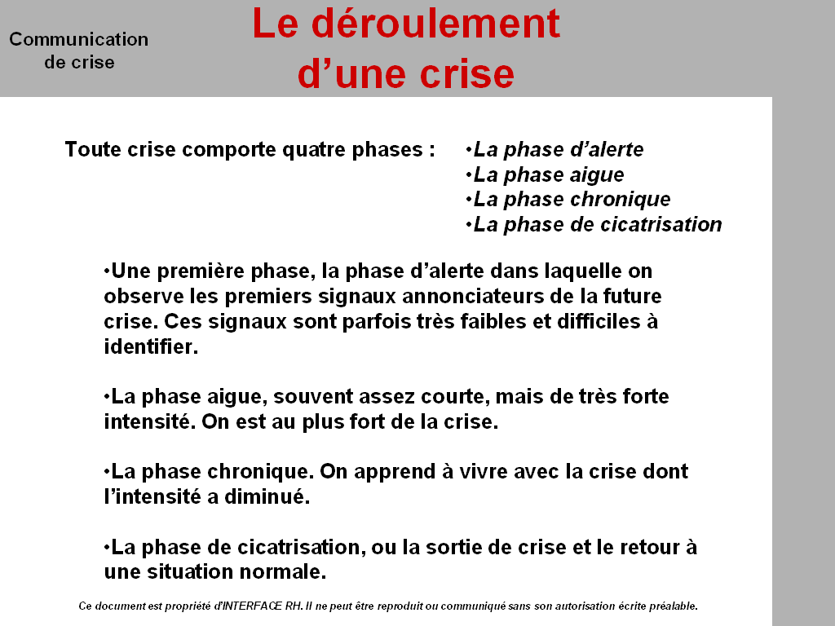
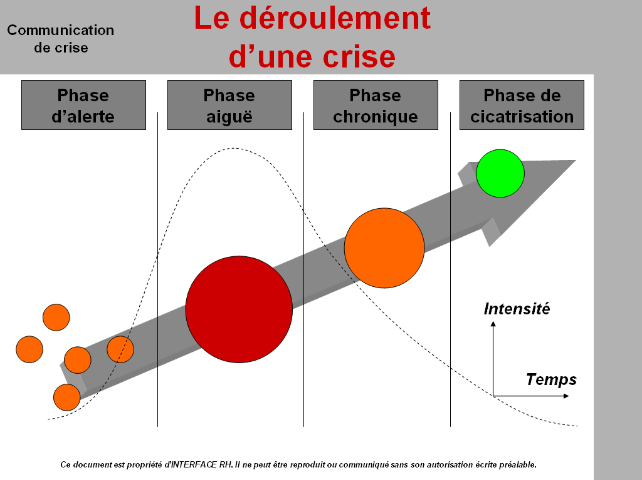
Slides
This is a good example of a slide used by a trainer during a training session on crisis communication methods. To illustrate the different phases and differences of intensity, the trainer uses different colors and forms size.
The slide gives a clear and global view.
The same slide without taking care of principles for creation and illustration. The results is a very linear view.

Slide 8
Organisation of a slide
Basic slide. Information presented are the liste of names only
1
André
Charles
David
François
Louis
Michel
Pierre
One modification about the color and/or the size of some caracters gives one additional information : le name of the captain.
Our hand-ball team
André
Charles
David
François
Louis
Michel
Pierre
Our hand-ball team
Our hand-ball
team
2
3
François
Still without additional words, this organisation within the slide gives one more important information : each player’s position in the team.
André
David
Pierre
Louis
Charles
Michel
Source : Eyrolles

Slide 9


Presenting data
Difficult to understand what you want to highlight with this table.
A
456
468
356
731
236
A
B
C
D
E
Pierre
456
123
34
86
354
François
468
231
Comment
37
98
356
Julie
356
341
75
103
753
A
B
C
D
E
Arnaud
791
253
63
26
324
Louise
236
426
98
79
487
Pierre
456
123
34
86
354
Elise
529
326
61
67
617
François
468
231
37
98
356
Jacques
345
124
37
152
968
Julie
356
341
75
103
753
Mathilde
897
99
82
12
732
Arnaud
791
253
63
26
324
Benoît
432
231
75
99
148
Too much number,
too small
Louise
236
426
98
79
487
Vincent
684
270
81
57
427
Elise
529
326
61
67
617
Jacques
345
124
37
152
968
Mathilde
897
99
82
12
732
Benoît
432
231
75
99
148
Vincent
684
270
81
57
427
D
86
98
103
26
79
A
B
C
D
E
Pierre
456
123
34
86
354
You put in the (loupe) data you want to highlight by making them big and clear..
François
468
231
37
98
356
Julie
356
341
75
103
753
Arnaud
791
253
63
26
324
Louise
236
426
98
79
487
Comment
Elise
529
326
61
67
617
Jacques
345
124
37
152
968
Mathilde
897
99
82
12
732
Benoît
432
231
75
99
148
Source : Eyrolles
Vincent
684
270
81
57
427

Slide 10

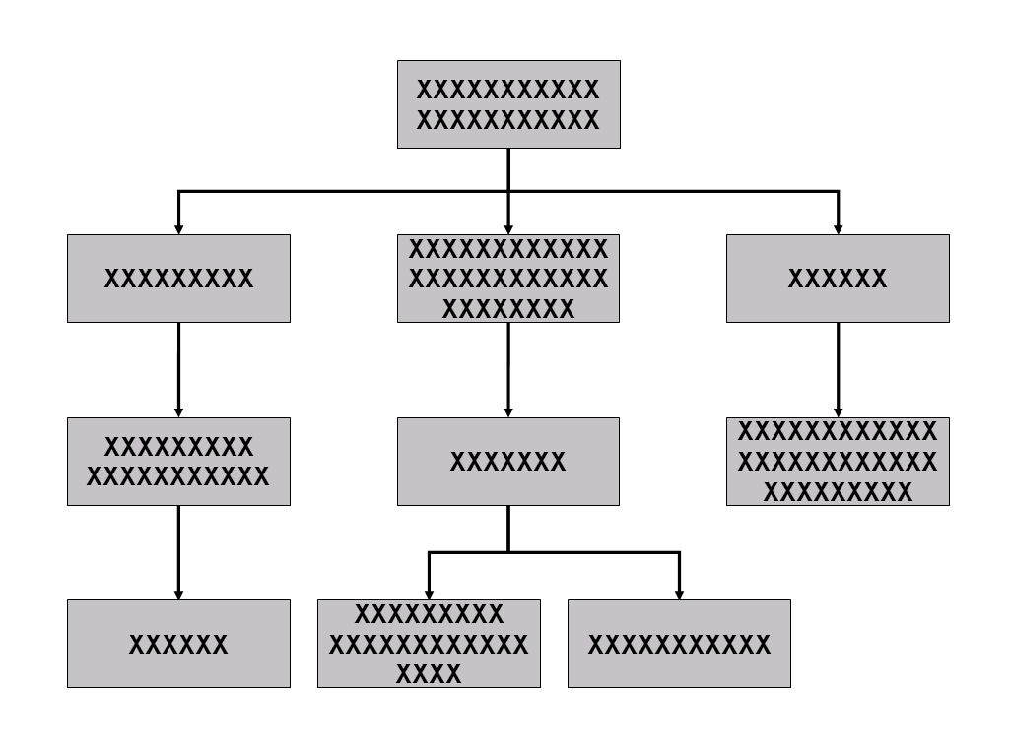
The trainer and his visuals
He reads the visuals, and « forgets » the trainees.
Linear approach
Trainer
Systemic appraoch
He doesn’t read the visual, and stay in close contact with the group.
Trainer
Source : Eyrolles

Slide 11
Reminders about slides
One theme by slide
20 to 25 words by slide
Images, drawings, colors !
Test your slides :
  Can you read them at a 4 to 5m distance
  How long does-it take to read the content.
  How many slides do you have ?
    Some sequences can have more slides than others
    A training session is not a conference, or a presentation of results.
  Are there images and illustrations ?

